Slide 1
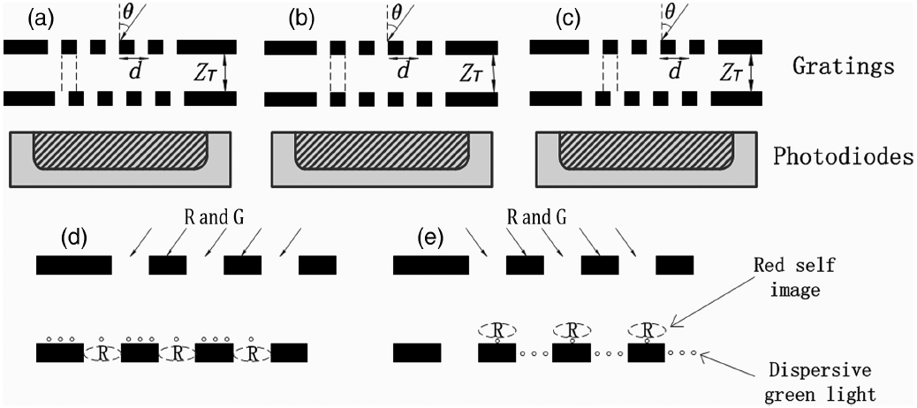
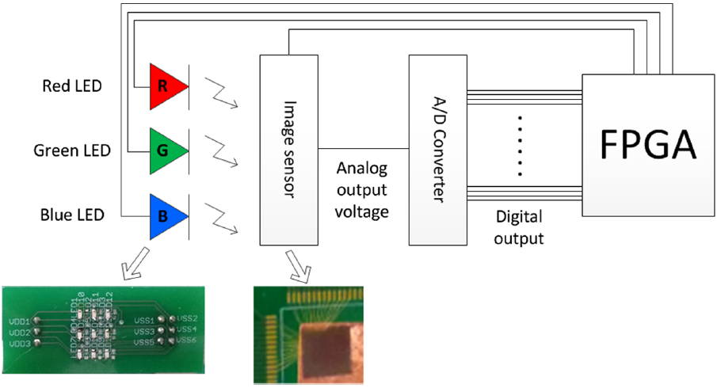
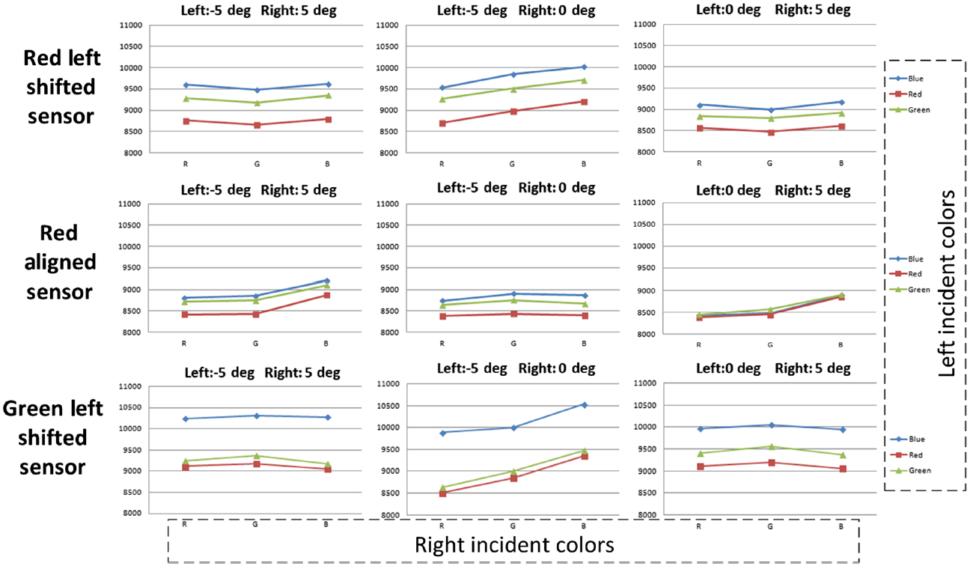
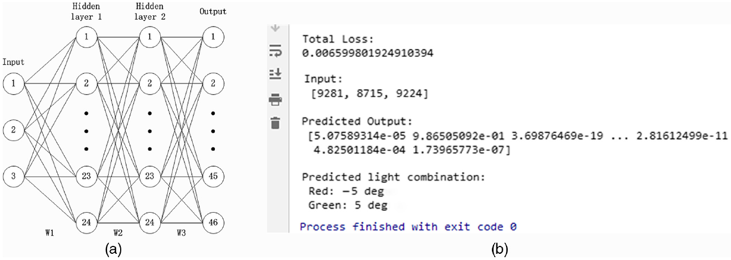
A field effect photo sensor suitable for a proximity optical communication scheme
Wei Chao, Sang Hoon Hong
Department of Electronic Engineering,Kyung Hee University,Yongin,Korea
(chaowei@khu.ac.kr)
A lens-less light field image sensor configuration is presented to realize a proximity light communication system from multi light emitting diode (LED) clusters with different incident angles. The light field image sensor is fabricated on a standard complementary metal oxide semiconductor (CMOS) process and utilizes the Talbot effect. Two metal layers are stacked above the photodiode acting as diffraction gratings at the top and masking layer at the bottom placed at Talbot depth to either pass or block the incident light. In particular, we introduce a proximity optical communication scheme to achieve dual light communication from different incident angles with various wavelengths. To simplify the classification between different combinations of incident angles and wavelengths, deep neural network (DNN) is utilized. We reduced the number of light field image sensors by 50% and increased the transmission data bits per clock by 114% compared to our previous work. A range of 46 different types of blink combinations are tested from this single LED array considering up to dual lights communication. We achieved a maximum data rate of 251 kbit/s with the proposed prototype at 45.5 kHz sample rate. The proposed proximity optical communication scheme had power dissipations of 30.6 mW on a 1.8 V power supply for the sensor chip and 27.5 mW on a 3.3 V power supply for the LED array. This can be applied in the low power data IO communication between a compact cluster of chips.
The light field image sensor contains two grating layers and a photodiode. Two grating layers are placed at Talbot depth to take advantage of the Talbot effect. As shown in Fig. 1 (a), (b), and (c), the bottom grating layer is placed at the Talbot depth Z_{T} of the top grating layer with three different horizontal displacements, which are left shifted, aligned and right shifted configuration. For the shifted configuration, the top grating is horizontally moved to either left side or right side by a distance of 1/4 d, where d is the distance between adjacent grating slits, compared to the bottom grating.
Two dual light communication examples for the red selective right shifted configuration are shown in Fig. 1 (d) and (e). Since the grating pairs are designed for red selective, red light can generate the self image at the depth of bottom grating whereas the green light is dispersive at the depth of the bottom grating. If the incident angle of the dual lights is equal to the designed angular deflection , red self image can fully pass through the bottom grating, shown in Fig. 1 (d). As the incident angle changes, the red self image can partially pass through the bottom grating until it is fully blocked by the bottom grating, shown in Fig. 1 (e). On the other hand, the green light is dispersive and always partially pass through the bottom grating with the amount passing through depending on the incident angle.
Fig. 1 Three different conditions for two grating layers: (a) left shifted configuration, (b) aligned configuration, (c) right shifted configuration, and two Talbot effect examples of the red selective right shifted configuration for dual light communication: (d) Red & Green lights are incident from the designed angle, (e) Red & Green lights are incident from the masked angle
To evaluate the characteristics of the designed sensors, the test environment is set up as shown in Fig. 2. It includes a 3 x 3 chip LED array, a light field image sensor chip, an FPGA board, and an A/D converter. The chip LED array is mounted on an xyz micro-positioner that can adjust the position of the chip LED array. The LED array plane is parallel to the light field image sensor chip plane. A perpendicular distance of 3.5 cm is maintained from the green LED of the central RGB cluster to the center of the 3 x 2 image sensor array. To satisfy the incident deflection angles, which are approximately 5º for the shifted grating configuration, the inter chip LED cluster distance is designed to be 3.06 mm away from each other. In other words, a total of 3 incident angles are considered, which are left side (-5º), middle (0º), and right side (5º).
Fig. 2 The test environment for the image sensor array
Fig. 3 shows the measured ADC readout voltages for all the dual light combinations for red left shifted configuration sensor, red aligned configuration sensor, and green left shifted configuration sensor. In each sub-figure, the numbers for the y-coordinates is the analog readout voltages from the ADC converter, which has a resolution of 0.18 mV per value with its common at 8192. Besides, three lines stand for three different incident colors from the left angle of the dual angle combinations and the x-coordinates stand for the incident colors of the right angle of the dual angle combinations. For instance, left angle and right angle are -5º and 0º respectively for angle combination -5 and 0 degree whereas 0º is the left angle for the angle combination 0 and 5 degree.
To implement the proximity light communication, a DNN configuration is used to classify the light combinations, which is shown in Fig. 4 (a). Fig. 4 (b) shows an example of tested result for the dual light communication. The total loss indicates the entire mean error between the results of last forward propagation and the training target after the training. Three inputs are the ADC readout voltages from three different sensors. The predicted output shows that the second neuron, which stands for the dual light combination of red from -5 degree and green from 5 degree, exhibits a highly likely value close to 1 amongst the whole output neurons.
Therefore, a light field image sensor array constructed from a conventional CMOS process to realize a proximity light communication scheme is presented. The feasibility of differentiating the incident wavelengths along with the incident angles are verified with a chip LED array without the use of optical elements. The proximity light communication scheme is proposed in this paper to send and receive chip LED light combinations. The receiver is comprised of three photodiodes with different grating pairs. The proposed scheme shows robust characteristics to distinguish the light combinations at 45.5 kHz blink rate. Using our DNN approach number of simultaneous LED lights and incident angles can be increased. Thus, for n LEDs, up to 2^{n} blink combinations are possible.
Fig. 3 The measured ADC readout voltages for dual light combination
Fig. 4 The measured ADC readout voltages for dual light combination
Acknowledgement The chip fabrication and EDA tool were supported by the IC Design Education Center(IDEC)

